Slide 1
LANGUAGE
SUBJECT; | Language
GRADE; | 3
TERM; | 1

Slide 2

TIMELINE
WEEK 1-2 | ME AND MY TIMELINE
WEEK 2-3 | ME MY RIGHTS AND RESPONSIBILITIES
WEEK 3-4 | MY FEELINGS AND EMOTIONS
WEEK 4-5 | CHANGES IN ME
.

Slide 3
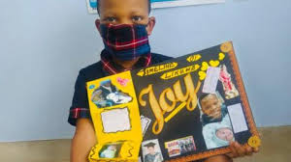
ME AND MY TIMELINE
Group 1
LEARNERS ARE REQUIRED TO WATCH THIS PICTURE AND MAKE A COLLAGE OF THEIR OWN TIMELINE WITH THEIR PICTURES AND LIFE EXPERIENCES.

Slide 4
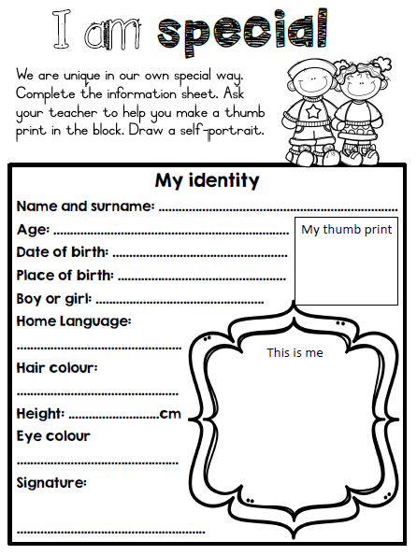
Group 2

Slide 5
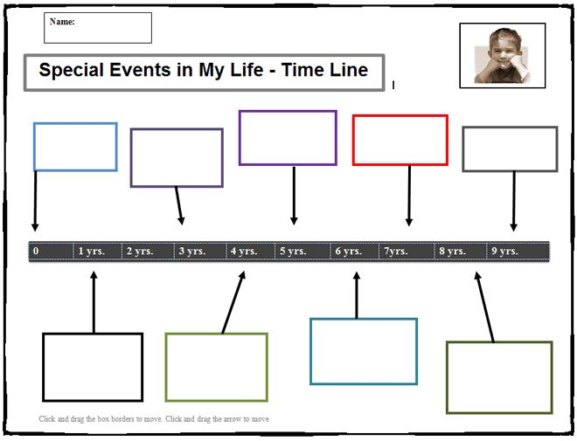
GROUP 3
.

Slide 6
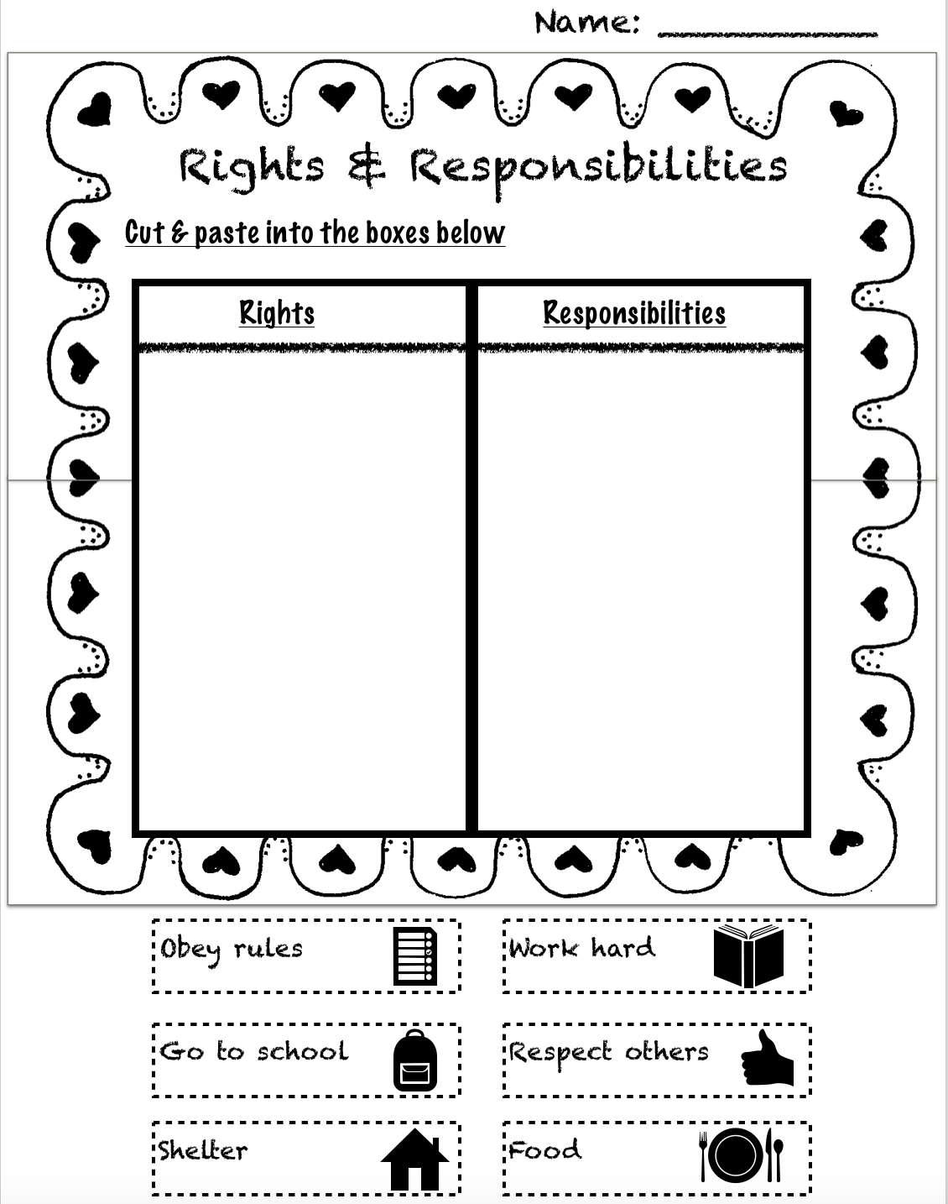
ME MY RIGHTS AND RESPONSIBILITIES
GROUP 1
LEARNERS ARE REQUIRED TO PASTE THE RIGHT ANSWERS ON THE RIGHT COLOUMN

Slide 7
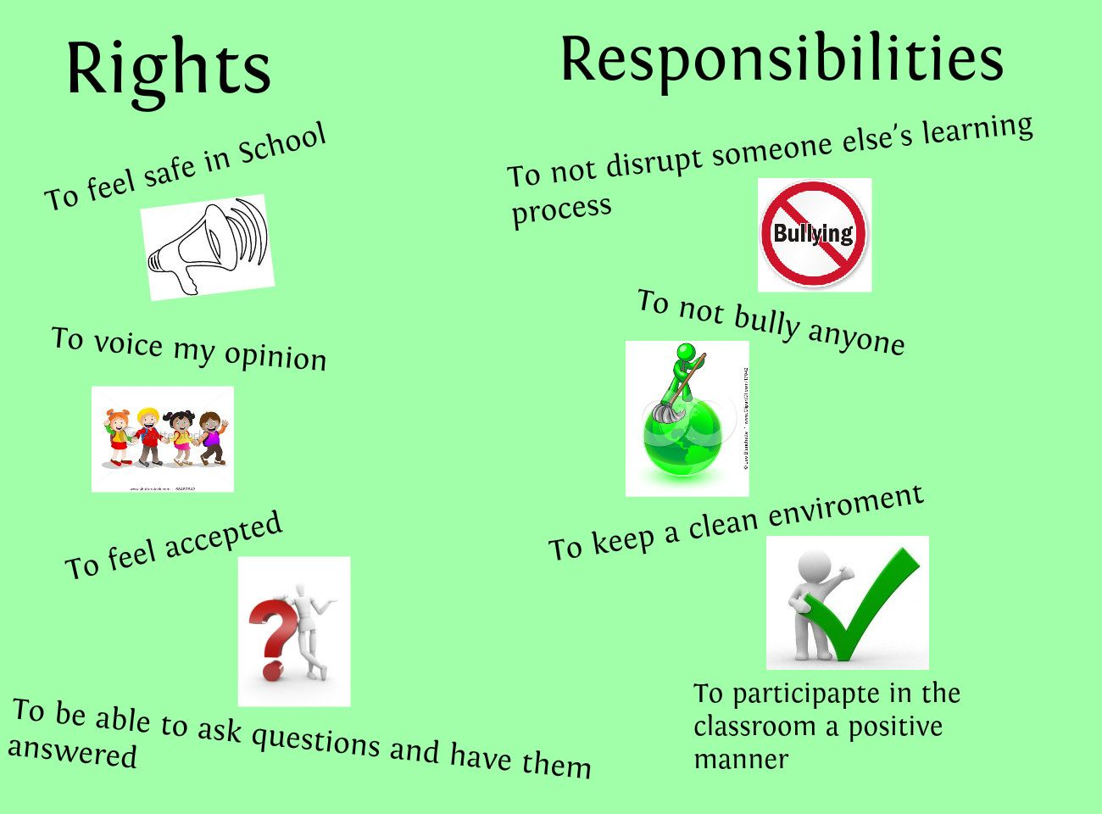
GROUP 2
A specific group of learners will be required to do a chart like this, complete the sentences correctly.

Slide 8
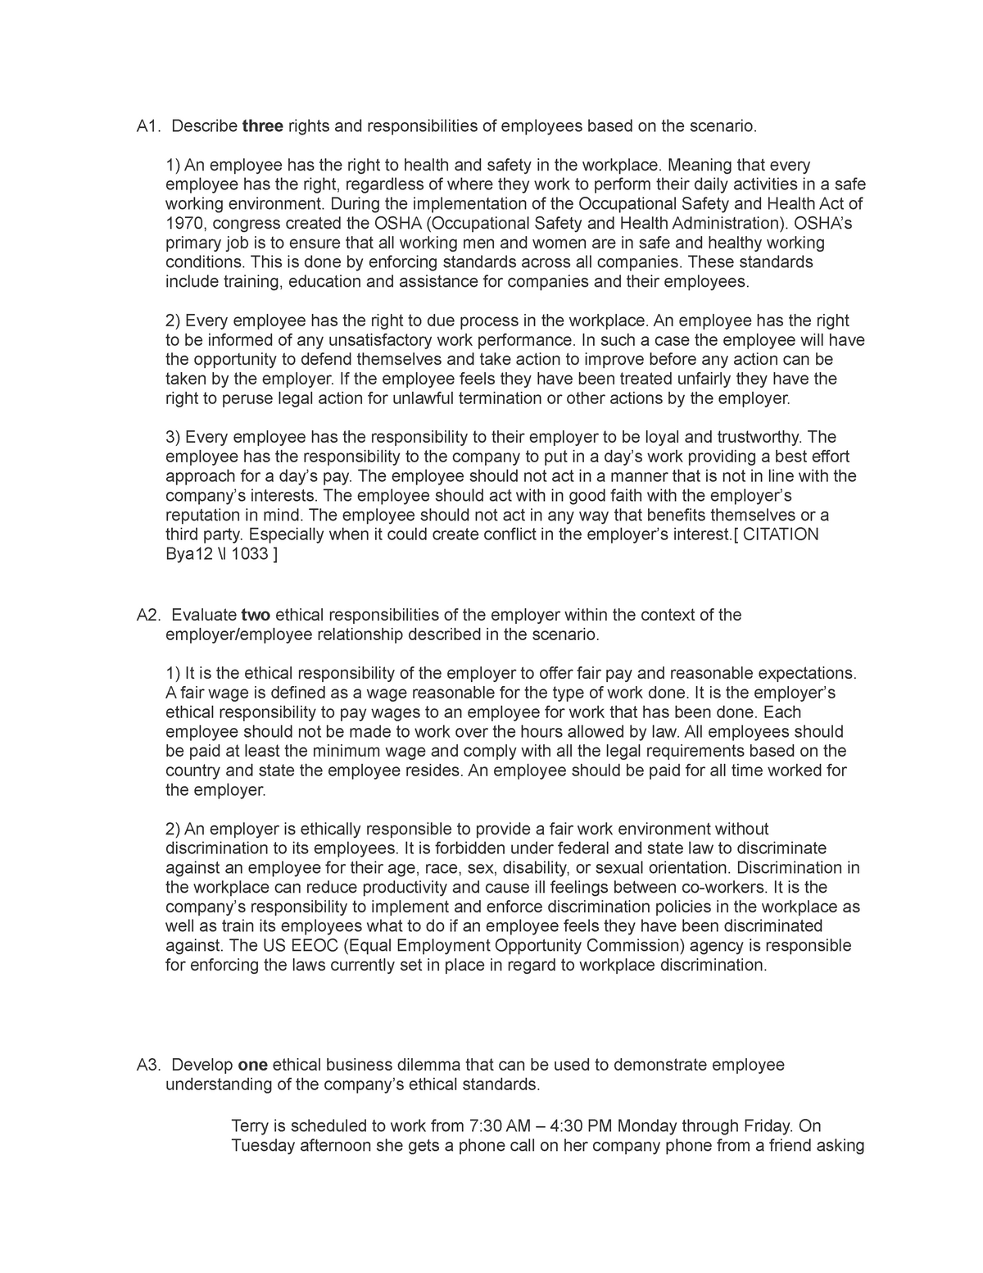
Group 3
Learners will be required to identify initially sounds and rhyming words in this picture.
They must highlight initial sounds with green and rhyming words with red.

Slide 9
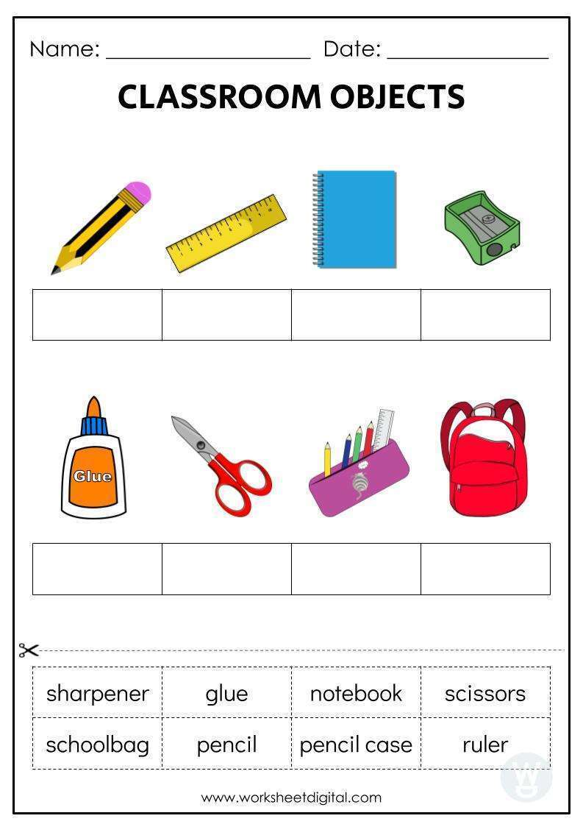
MY FEELINGS AND EMOTIONS
Learners will have to recognize and paste the name of each object correctly.
GROUP 1

Slide 10

MY FEELINGS AND EMOTIONS
Goup 2

Slide 11
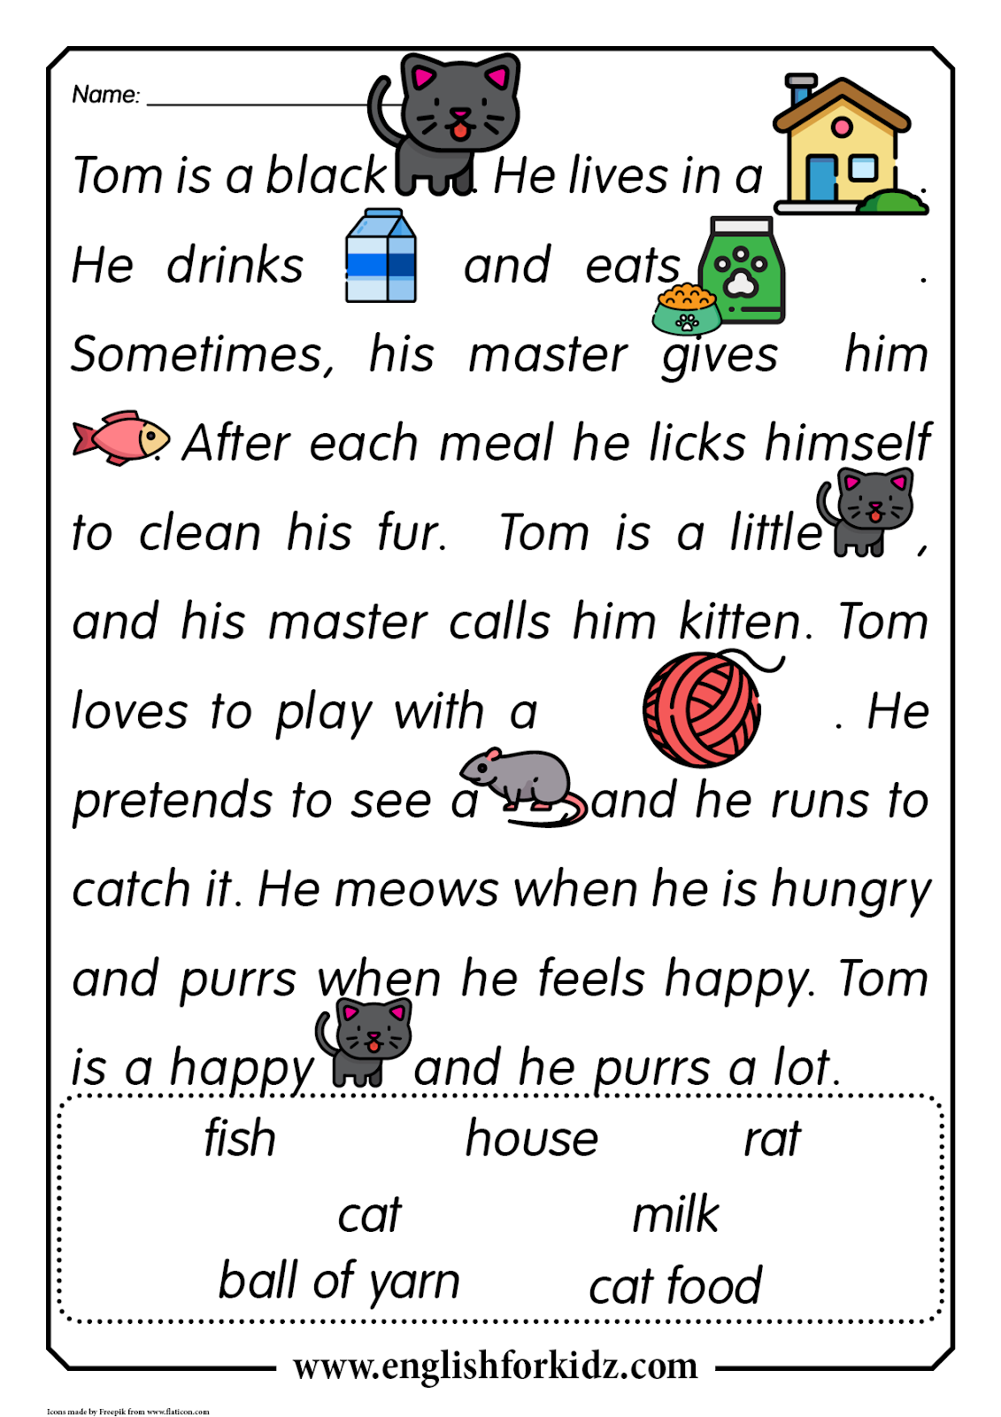
MY FEELINGS AND EMOTIONS

Slide 12
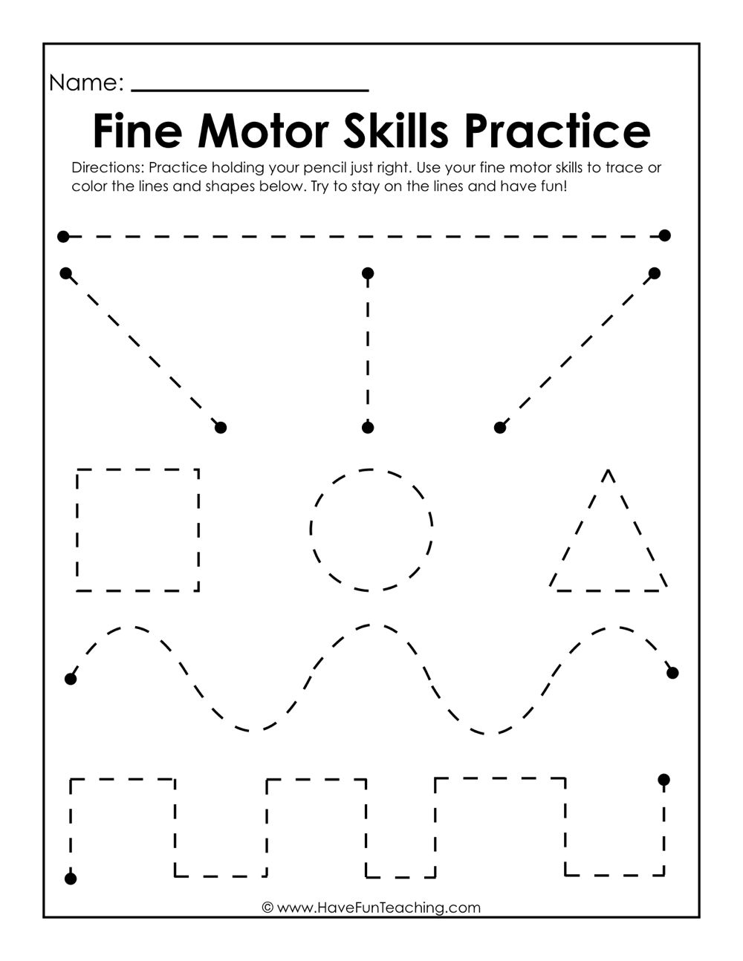
Changes in me.
Group 1

Slide 13
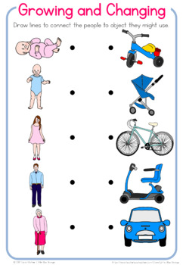
Changes in me.
Group 2

Slide 14
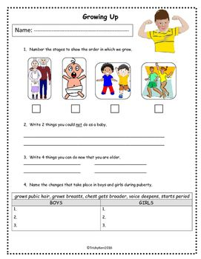
Changes in me
Group 3

